Slide 1




Web scraping and review analysis to gain company insights

Slide 2
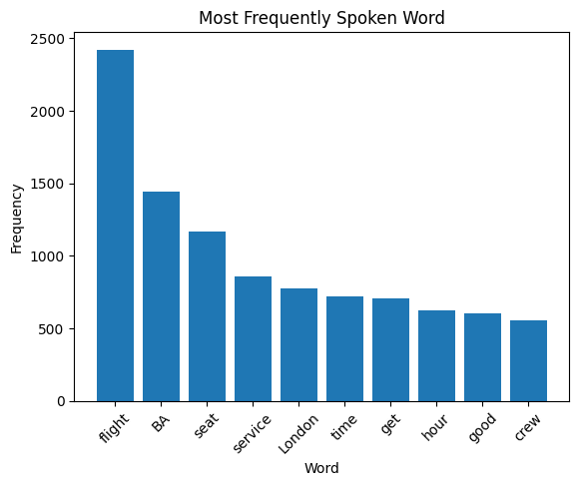
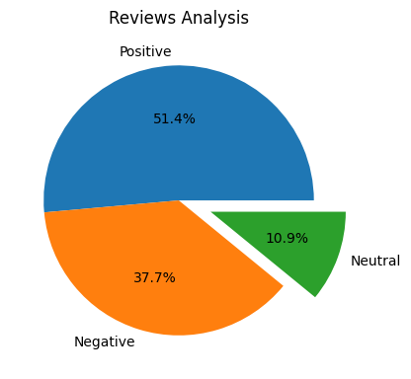
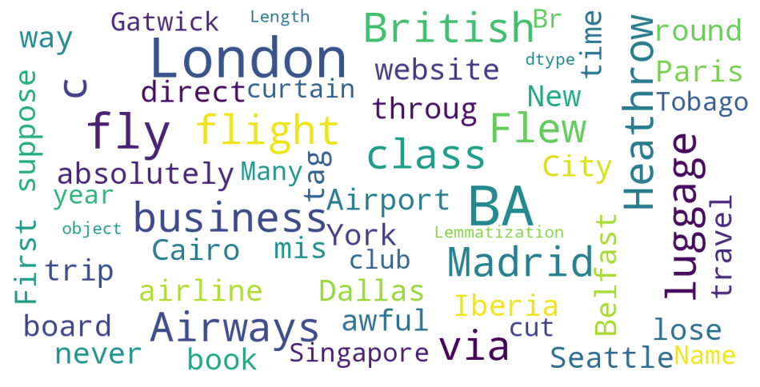
From cleaning 1200 reviews given by the customers, we obtained :
Positive Reviews : 617
Negative Reviews : 452
Neutral Reviews : 131
This frequency chart at the top right shows that key topics within the reviews include “flight”, “seat”, “service” and “crew”, showing that people are actively talking about their experience and staff.
Word cloud of keywords used in reviews:

